Slide 1

SSID: WWCode
Password: icecream12345

Slide 2
MACHINE LEARNING AND AI STUDY GROUP
Download these datasets:
http://bit.ly/2os5SHm
http://bit.ly/2phqFfT
Please answer the following form: http://bit.ly/2qzdys6
Having fun with AI:
https://quickdraw.withgoogle.com/
http://en.akinator.com/
https://aiexperiments.withgoogle.com/
Notes:
Please use only the three colors for the content.

Slide 3


MACHINE LEARNING AND AI STUDY GROUP
Twitter: @wwcodemanila
FB: fb.com/wwcodemanila

Slide 4
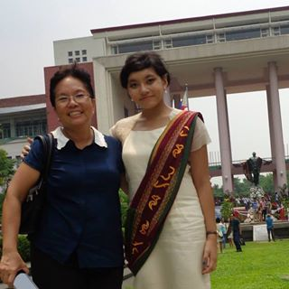
Isabelle Tingzon
Research Fellow II
Philippine-California Advanced Research Institutes (PCARI)
Graduate student of Computer Science
Notes:
Please use only the three colors for the content.

Slide 5
New Member’s Introduction

Slide 6

I am <name>
<your current profession>
<why did you join this study group?>
Notes:
Please use only the three colors for the content.

Slide 7
Introduction to
Machine Learning
(Beginners)
Notes:
Please use only the three colors for the content.

Slide 8
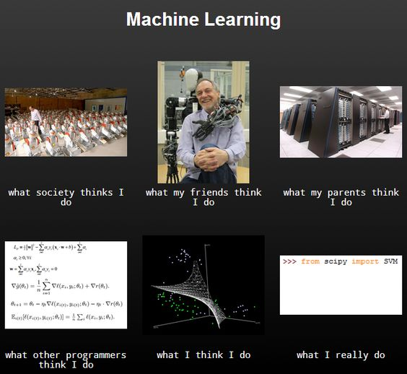

Slide 9
Machine Learning
A branch of AI that gives computers the ability to learn from examples and experience without being explicitly programmed.

Slide 10
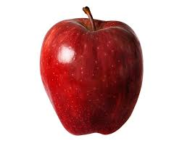
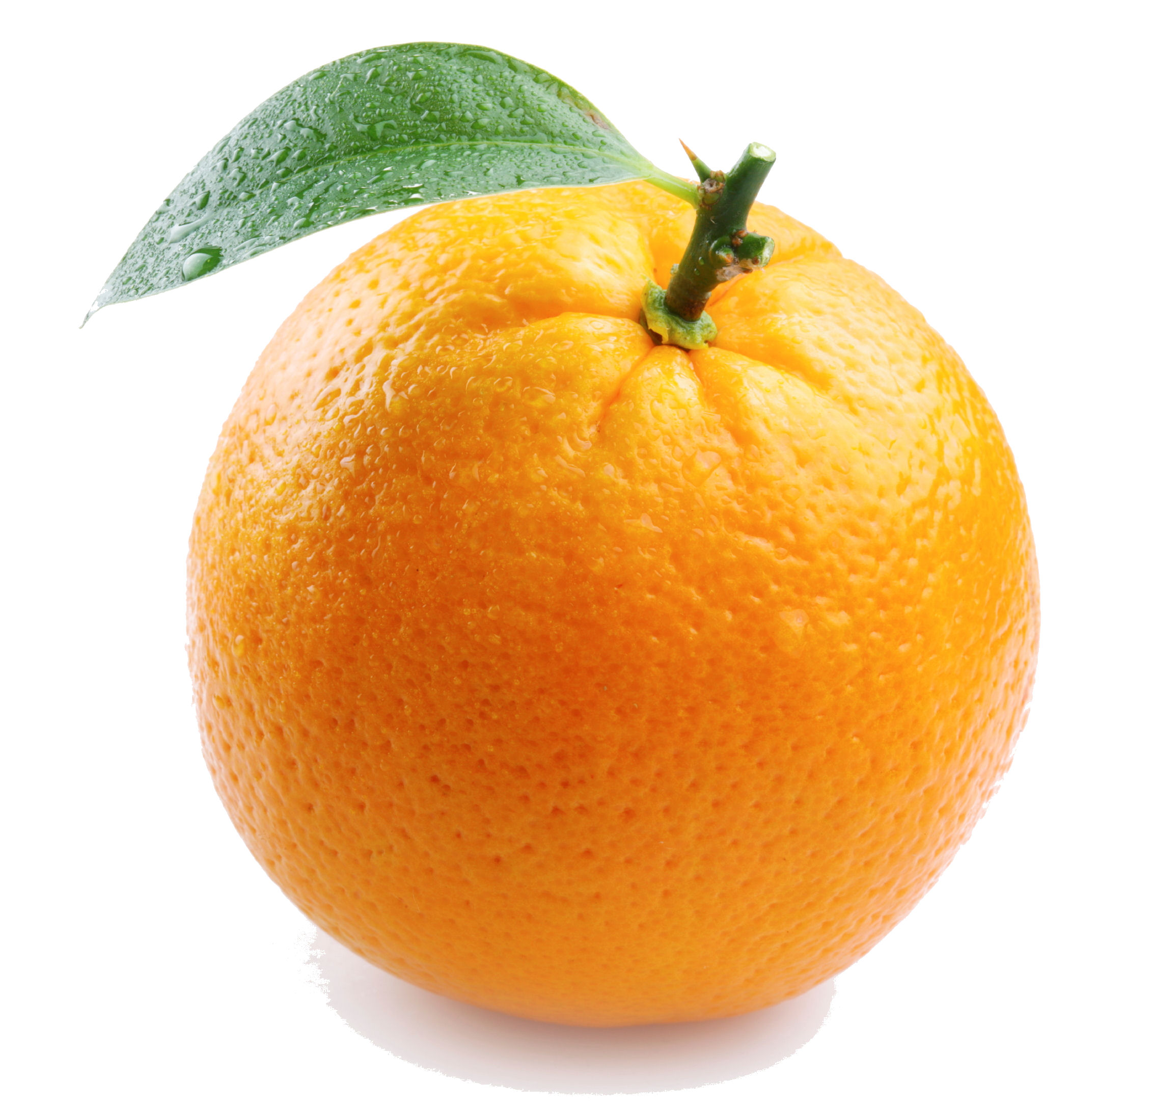
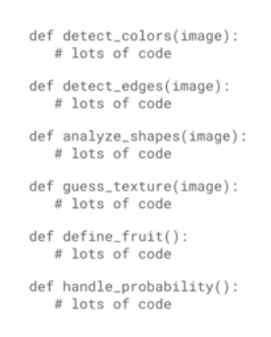
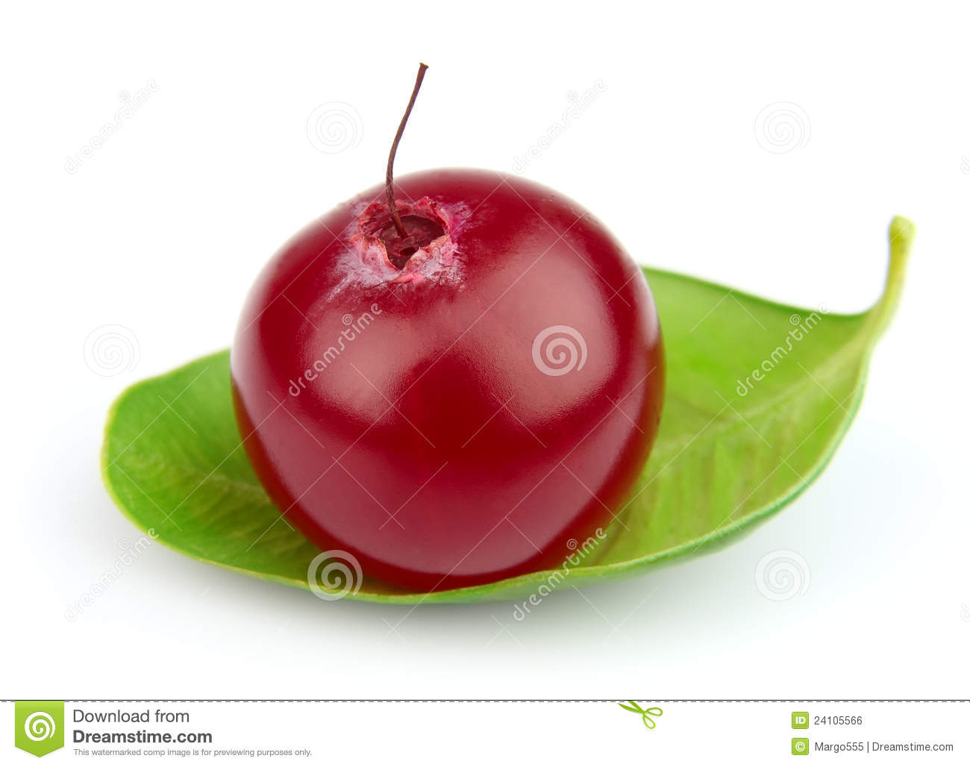
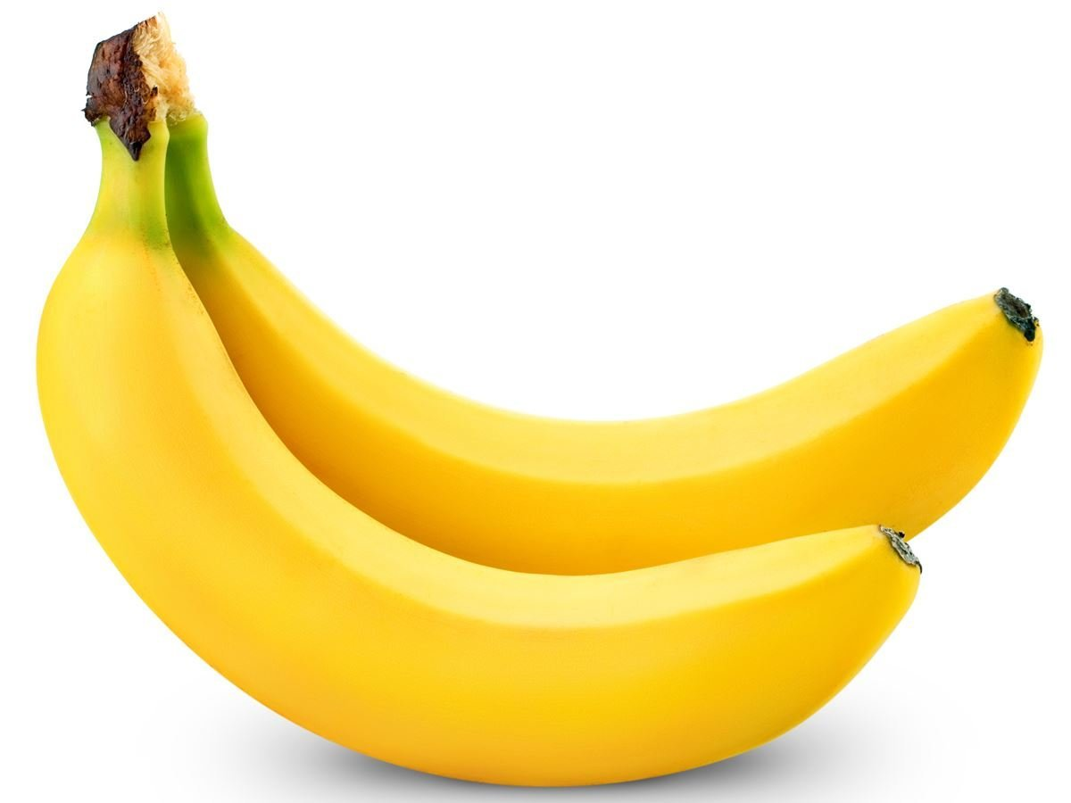
Write a program to classify images
Manually program rules:

Slide 11
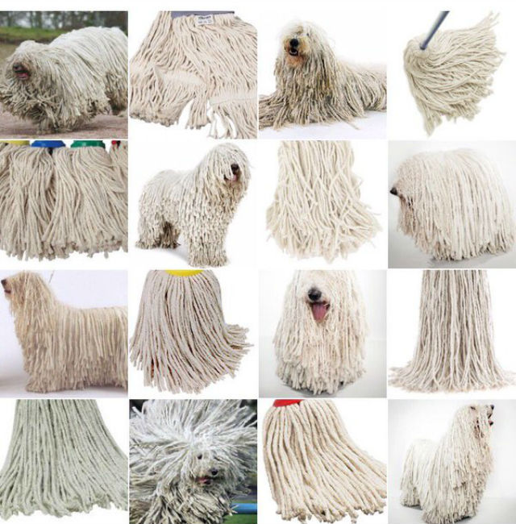
Write a program to classify images
Manually program rules:

Slide 12

Classifiers and Learning Algorithms
Learns the rules for us so that we don’t need to explicitly program it!
A function that takes data as input and assigns a label as output
apple

Slide 13

Classifiers and Learning Algorithms
Learns the rules for us so that we don’t need to explicitly program it!
A function that takes data as input and assigns a label as output
spam

Slide 14

Classifiers and Learning Algorithms
Learns the rules for us so that we don’t need to explicitly program it!
A function that takes data as input and assigns a label as output
Mark

Slide 15
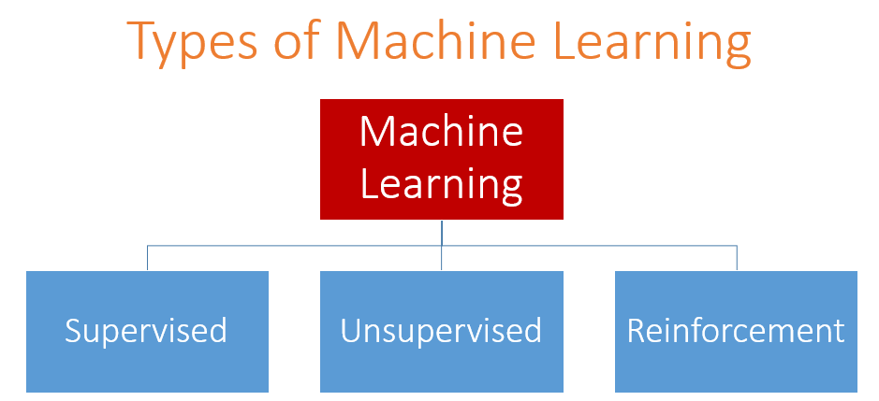
Data is labelled.
Data is unlabelled.
Algorithm learns to react to an environment
Classification/Prediction
Clustering/Association
We’ll be focusing on this for now.

Slide 16
Supervised Learning
Labels are given.
Classification task: Breast Cancer (malignant or benign)
x
x
x
- Malignant
x
Labels
x
o
- Benign
x
o
x
x
Age
o
x
o
o
x
More features
Clump thickness
Uniformity of cell size
Uniformity of cell shape
…
o
o
o
Tumor Size
Features

Slide 17
Unsupervised Learning
Labels are not given.
Algorithm tries to find inherent structures within the data.
o
Examples:
Market Segmentation (Cluster Customers)
Social Network Analysis
DNA Sequencing (group sequences into gene families)
o
o
o
o
o
o
o
o
o
o
o
o
o

Slide 18
Applications of Machine Learning
Database mining
Large datasets from growth of automation/web.
e.g., Web click data, medical records, biology, engineering
Applications can’t program by hand.
e.g., Autonomous helicopter, handwriting recognition, most of Natural Language Processing (NLP), Computer Vision.
Self-customizing programs
E.g., Amazon, Netflix product recommendations

Slide 19
Machines that can compose sonnets.
When I in dreams behold thy fairest shade Whose shade in dreams doth wake the sleeping morn The daytime shadow of my love betray’d Lends hideous night to dreaming’s faded form Were painted frowns to gild mere false rebuff Then shoulds’t my heart be patient as the sands For nature’s smile is ornament enough When thy gold lips unloose their drooping bands As clouds occlude the globe’s enshrouded fears Which can by no astron’my be assail’d Thus, thyne appearance tears in atmospheres No fond perceptions nor no gaze unveils Disperse the clouds which banish light from thee For no tears be true, until we truly see

Slide 20
And Rap (DopeLearning)
The smell of success I want y'all to get a whiff of this
Teaching us how to hate but does it in a way that we love it
Happy birthday baby
To sit with white folks in a meetin' pleasebaeleaveit
But if I pop the trunk its to hand you a rag
I had to jump in my car and call you a cab
Least common denominator raise truth like Charlie Willy and Gramps

Slide 21
Compose Music (Aiva)
Play Video Games.
Mi.Mu. Gloves
(Gesture Recognition)

Slide 22
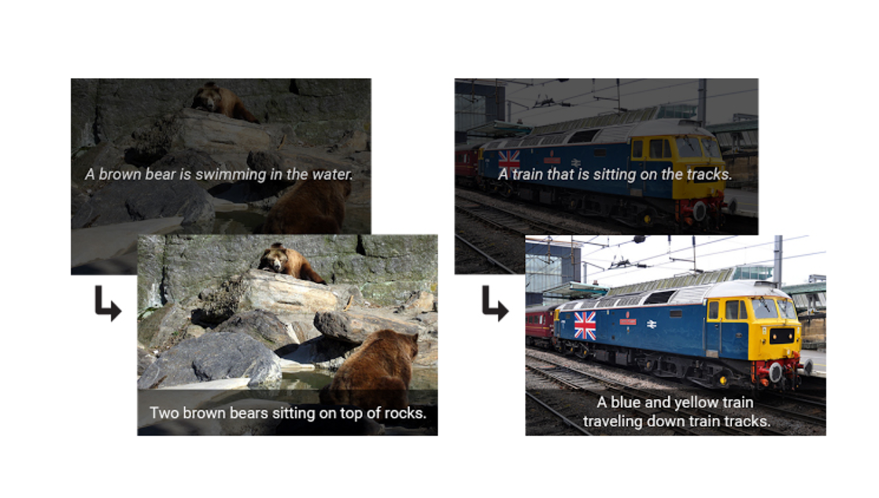
Google Image Captioning (94% accuracy)

Slide 23
Three Components of ML
Patterns exists
Cannot express the function mathematically
Data (lots of it!)

Slide 24
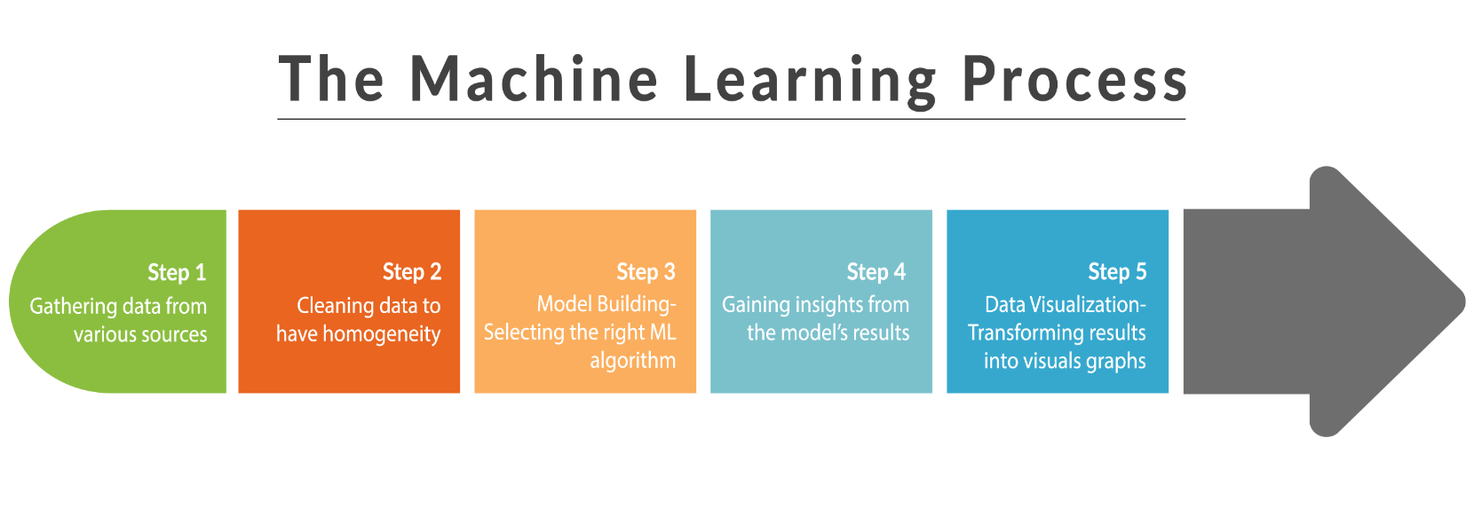
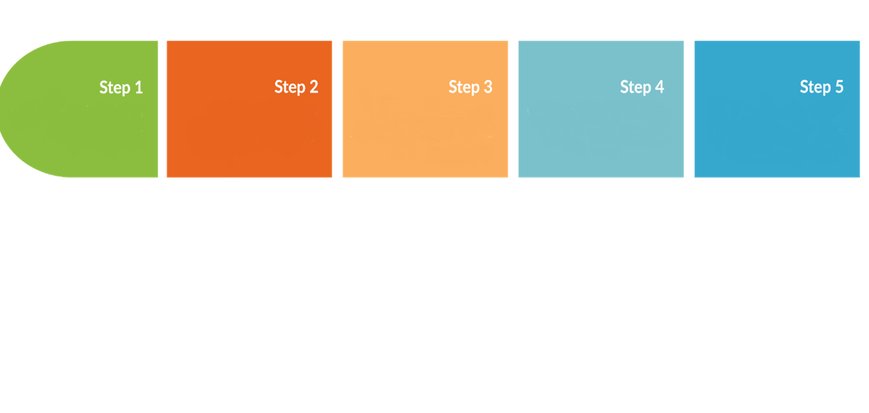
Model Building- Selecting the right ML algorithm
Gathering and cleaning data
Extracting features
Prediction and Evaluation
Present Results

Slide 25
Dataset: Heart Disease
Class/ Label/ Target attribute
Features/ Attributes
ID | Name | Age | Weight (kg) | Exercise | Smoker | Family History | Risk
1 | Maria Lopez | 24 | 55 | Daily | False | False | Low
2 | Jack Daniel | 55 | 75 | Rarely | True | True | High
3 | Marie Clare | 21 | 53 | Weekly | False | False | Low
4 | Alan Turin | 31 | 60 | Daily | True | True | High
5 | John Newman | 35 | 55 | Weekly | False | False | Low
6 | Lina Corazon | 42 | 80 | Rarely | False | True | High
Examples/instances
Numerical
Nominal
Binary

Slide 26
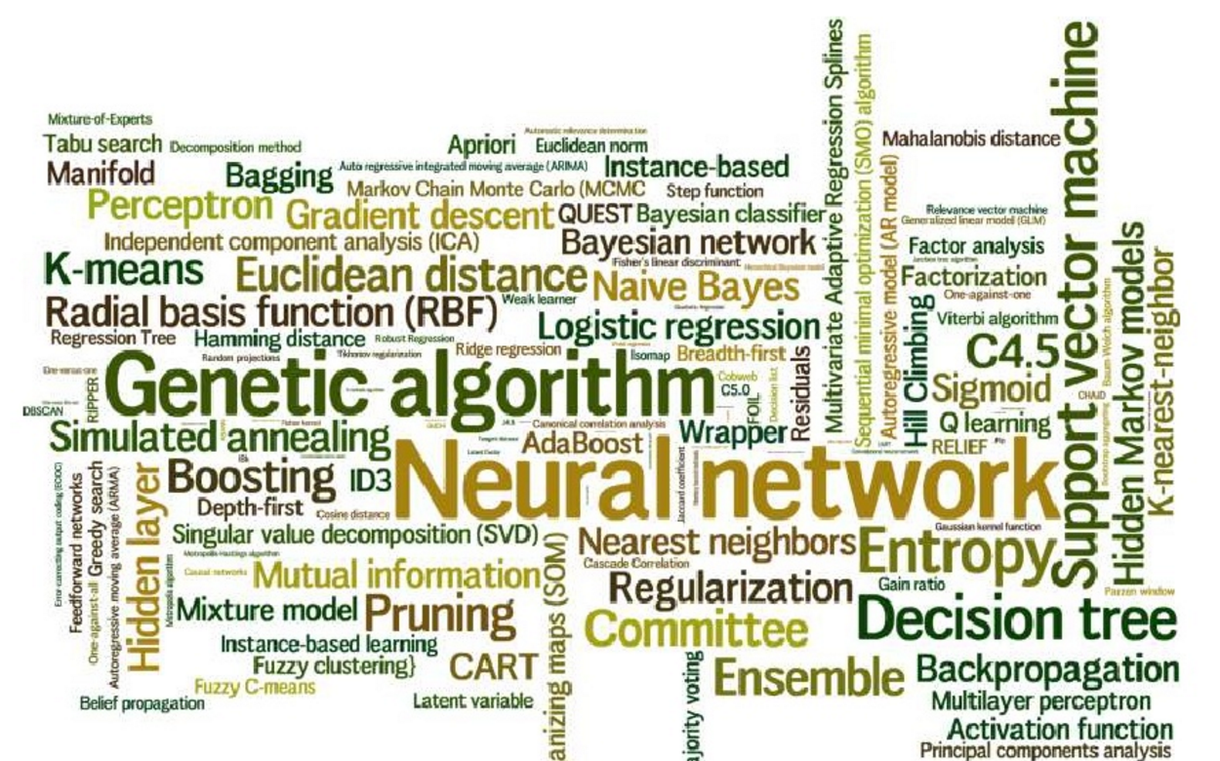
ML Algorithms
** For now we’ll treat these ML algorithms as a “black box”

Slide 27
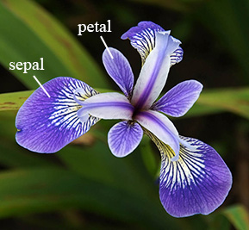
Exercise: Iris Plant Classification
Download the dataset at: http://bit.ly/2phqFfT
Each iris plant has 4 features/attributes:
Sepal Length
Sepal Width
Petal Length
Petal Width
Classify iris plants into 3 species:
Iris Setosa
Iris Versicolour
Iris Virginica

Slide 28
Let’s get started…
Install Anaconda (Python)
Why Anaconda? It’s prepackaged with many scientific libraries (scipy, numpy, scikit-learn, matplotlib)
Run a simple ‘Hello World!’
Create a Python file containing: print(“Hello World”)
Run it in the Anaconda terminal.

Slide 29
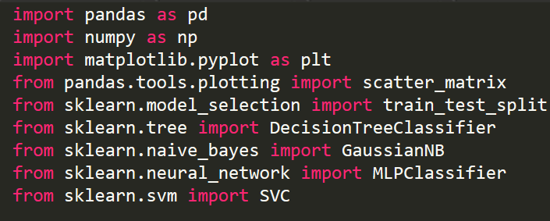
Import libraries
Data analysis, scientific computing tools
Data visualization
Machine learning algorithms

Slide 30
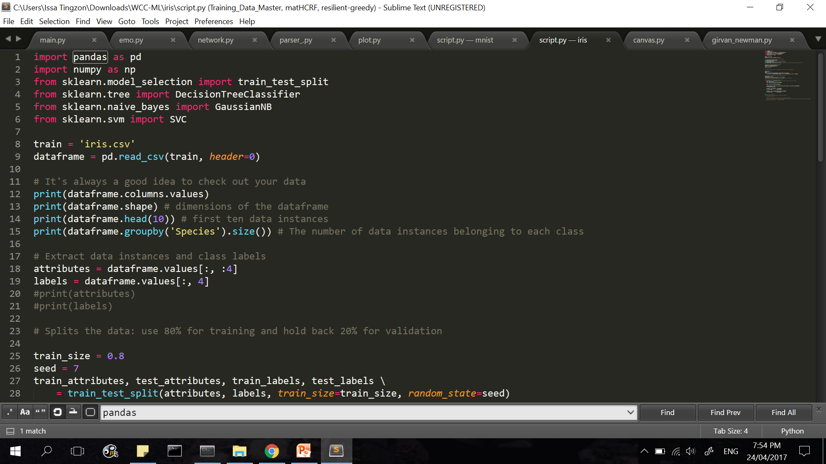
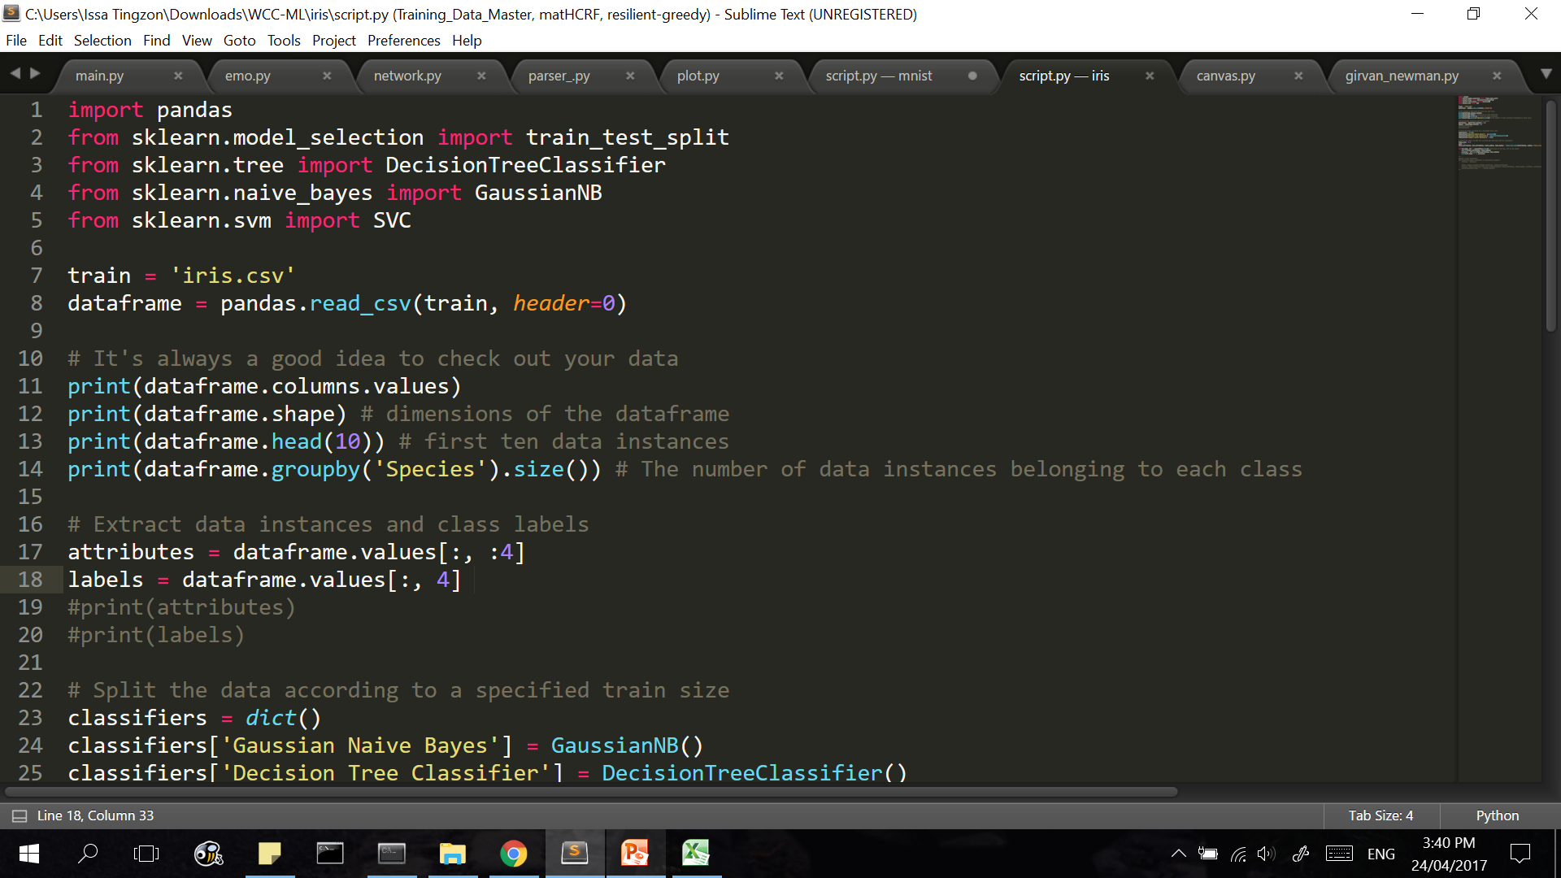
Specify that the first row of the dataset consists of the headers
Load data.
Reads the data as a Dataframe
It’s always a good idea to inspect your data.
Check dimensions of the Dataframe
Inspect the first 10 instances.
Class distribution: the number of instances belonging to each class.

Slide 31
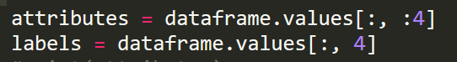
Extract attributes and class labels
Extract features/attributes of data instances
Index | 0 | 1 | 2 | 3 | 4
[headers] | Sepal Length | Sepal Width | Petal Length | Petal Width | Species
0 | 5.1 | 3.5 | 1.4 | 0.2 | Iris-setosa
1 | 4.9 | 3 | 1.4 | 0.2 | Iris-setosa
2 | 4.7 | 3.2 | 1.3 | 0.2 | Iris-setosa
… | ... | … | … | … | …
149 | 5.9 | 3 | 5.1 | 1.8 | Iris-virginica

Slide 32
Extract attributes and class labels
Extract classes/labels of instances
Index | 0 | 1 | 2 | 3 | 4
[headers] | Sepal Length | Sepal Width | Petal Length | Petal Width | Species
0 | 5.1 | 3.5 | 1.4 | 0.2 | Iris-setosa
1 | 4.9 | 3 | 1.4 | 0.2 | Iris-setosa
2 | 4.7 | 3.2 | 1.3 | 0.2 | Iris-setosa
… | ... | … | … | … | …
151 | 5.9 | 3 | 5.1 | 1.8 | Iris-virginica

Slide 33
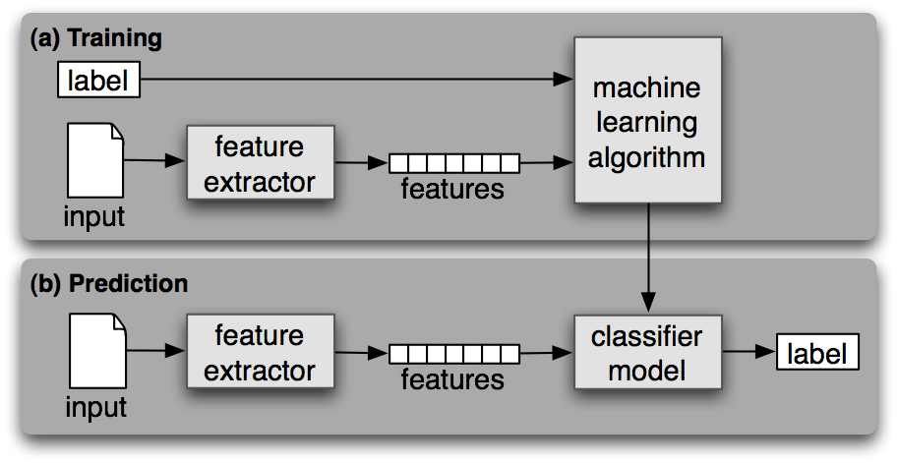
2 Phases of Supervised Learning
Training set
(Predicted)
Test set
Test labels
(Ground truth)

Slide 34
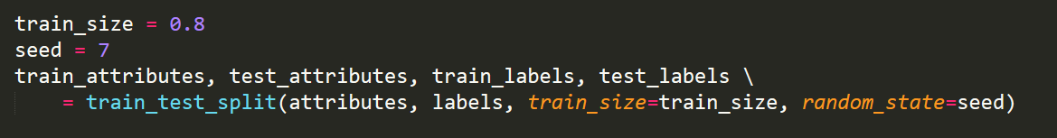
We need to split the dataset into (random) training and test sets.
Note that the size of the training set >> test set
Example: Training set is 80%, test set is 20%.
Luckily, there’s a built in function that does just that.

Slide 35
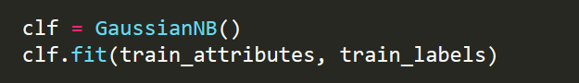
Training: Building the classifier model.
Choose a machine learning algorithm
Gaussian Naïve Bayes
Decision Trees
etc.
Train the classifier model on the training set.

Slide 36
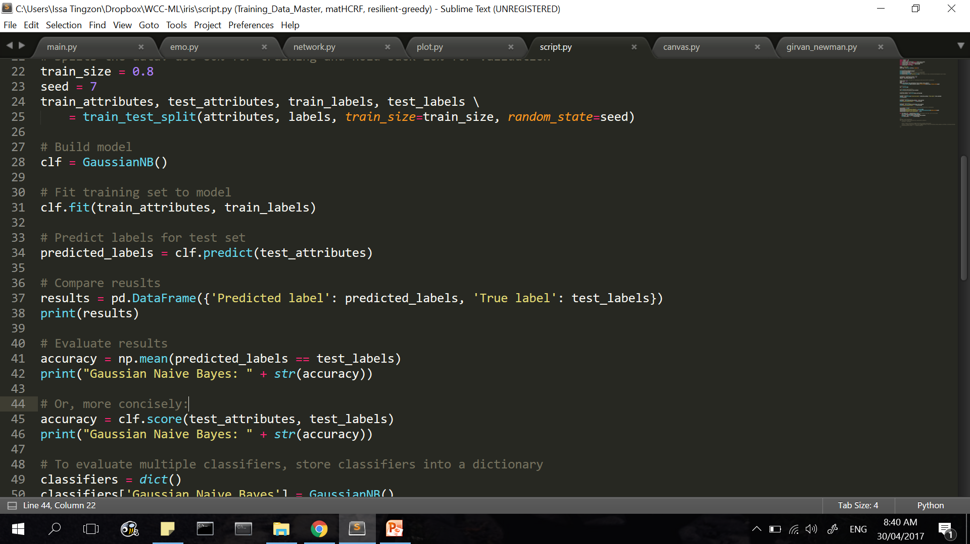
Testing: Evaluate the classifier model on the test set.
Predict the class labels (‘Species’) of the test set.
You can compare the predicted labels with the true labels (“ground truth”)

Slide 37
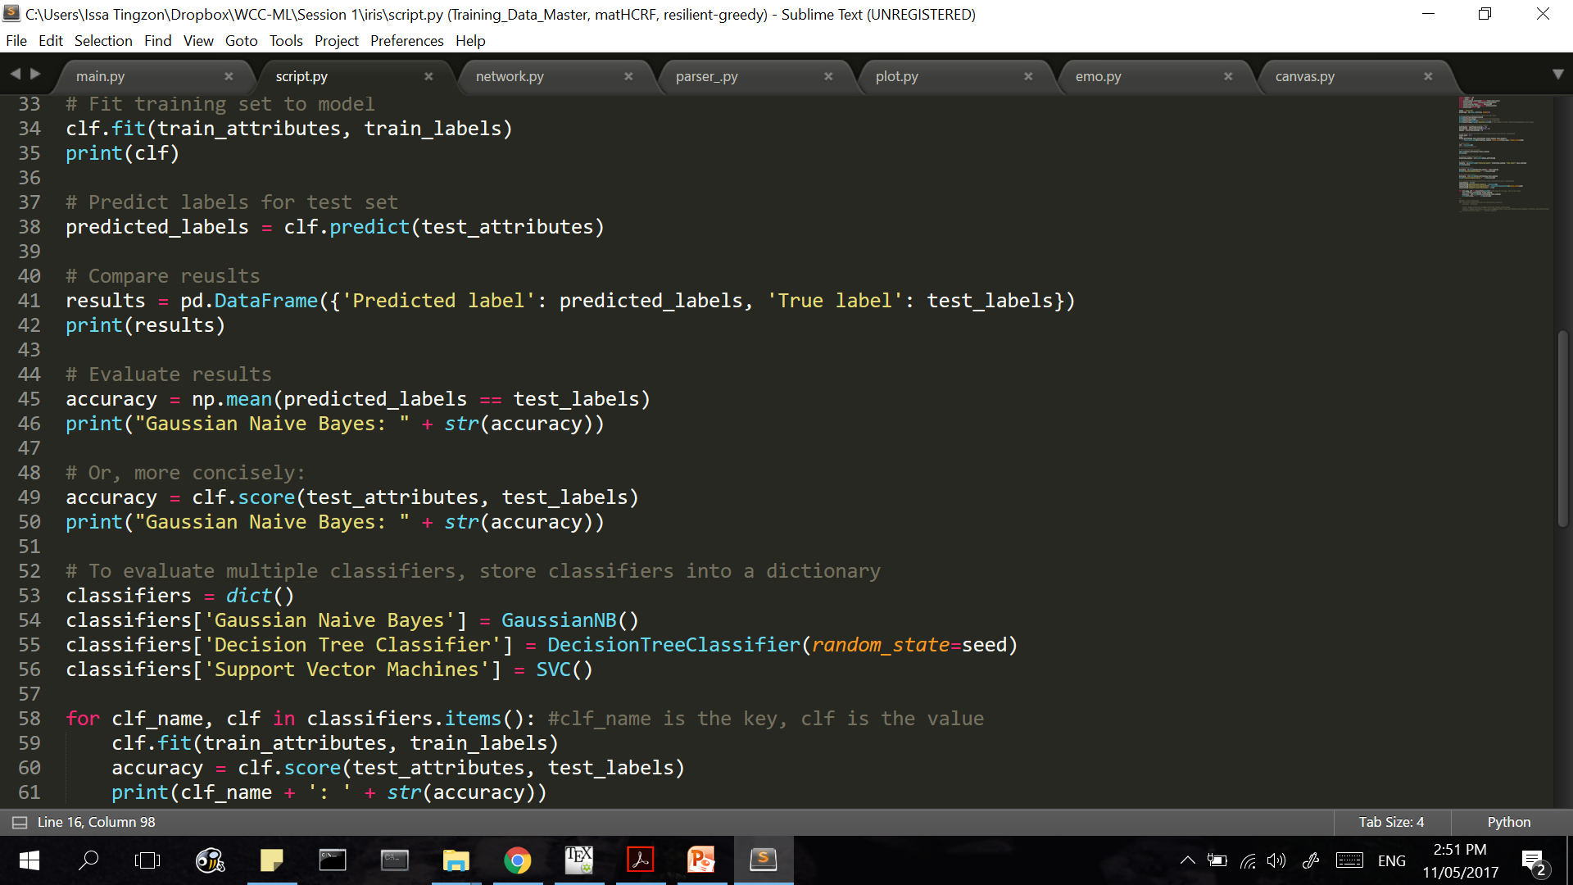
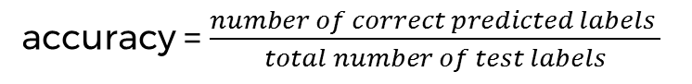
Evaluate accuracy. How well did our classifier model perform?
accuracy = $\frac{number of correct predicted labels }{total number of test labels}$
The closer the accuracy is to 100%, the better.
Tip: Steps 8 and 9 can be done with a single line of code:

Slide 38
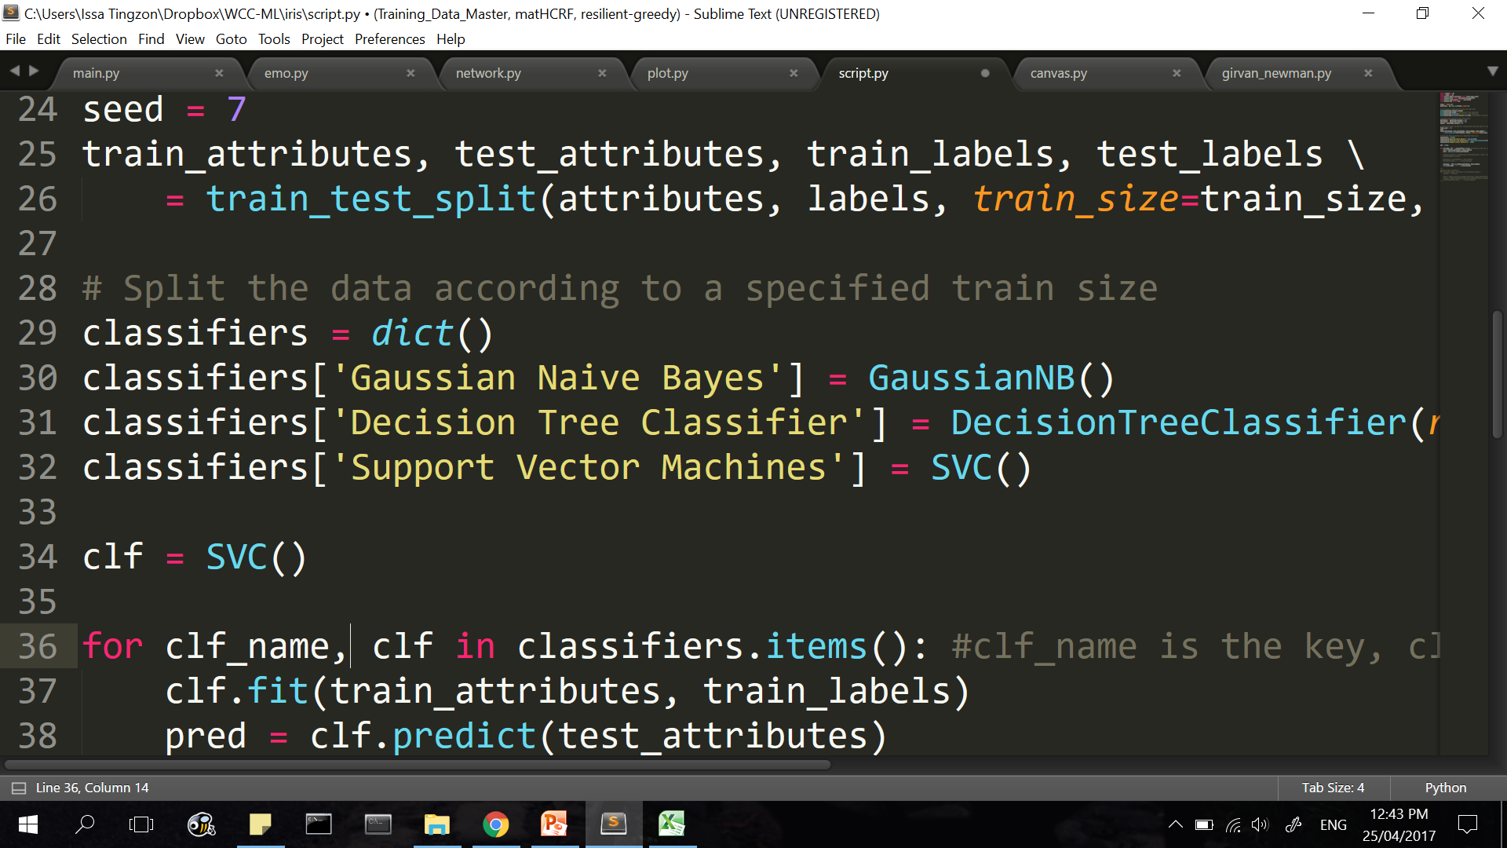
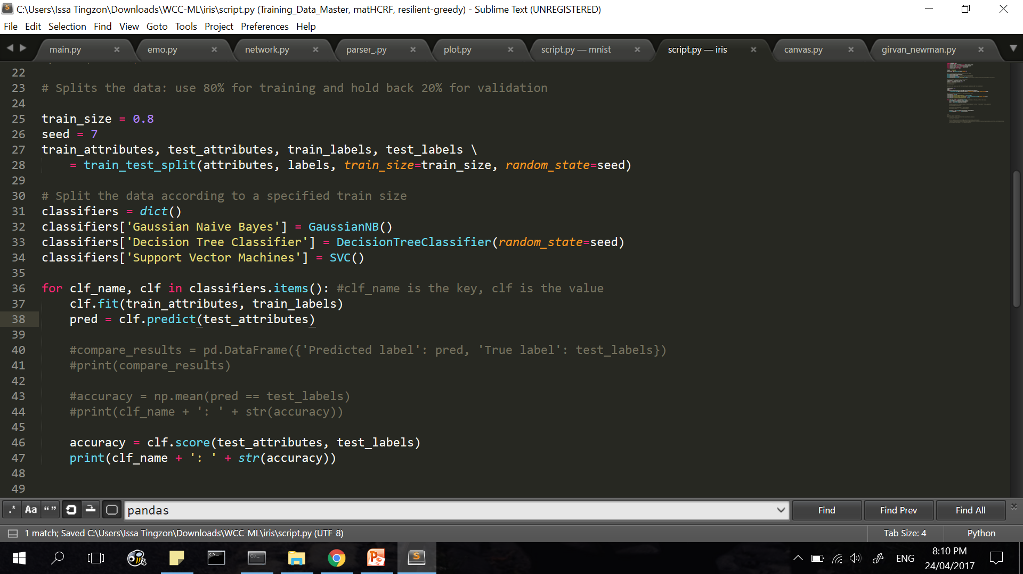
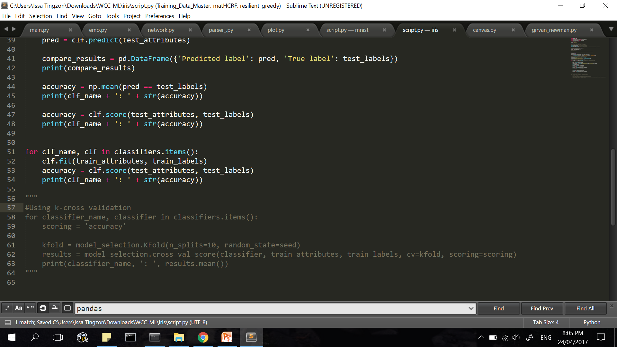
Great! 83% is good, but can we do better?
Try a different classifier. For example,
Or, you can store different classifiers into a dictionary.
Then iterate over this dictionary:

Slide 39
Present your results! ☺
Try searching the net for other classifiers and apply them to the problem:
Multi-layer Perceptron (MLP)
Random Forests
Adaboost
Neural Networks
k-Nearest Neighbour
etc.

Slide 40
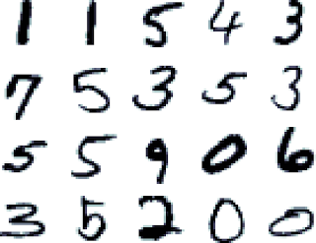
Assignment: Computer Vision – Handwritten Digit Recognition
Download the dataset: http://bit.ly/2os5SHm
The data files mnist.csv contains grey-scale images of hand-drawn digits, from 0 through 9.
Each image is 28 x 28 pixels, for a total of 784 pixels.
Each pixel has a single pixel-value, indicating the lightness or darkness of that pixel, with higher numbers meaning darker.
Each pixel-value is an integer between 0 and 255, inclusive.

Slide 41
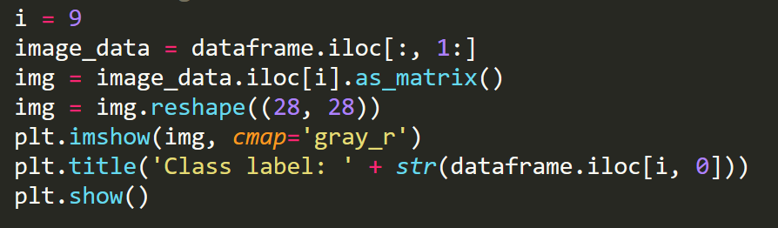
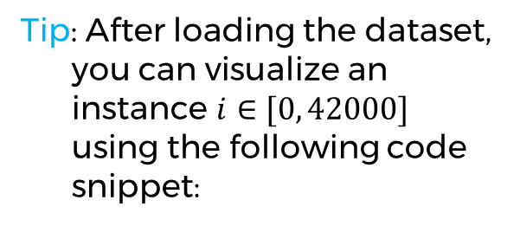
Assignment: Computer Vision – Handwritten Digit Recognition
Features/attributes: 784 pixels values
Classes: Labels 0-9 (first column of the dataset)
Exercise: Try using different classifiers to predict the labels of a test set generated using mnist.csv.
You can use our code from iris plant classification as a template
Tip: After loading the dataset, you can visualize an instance $i∈[0, 42000]$ using the following code snippet:

Slide 42
Future sessions
Linear Algebra Review: Vectors, Matrices, Vectorized computation
Under the Hood: ML Algorithms (Logistic Regression, Decision Trees, Naïve Bayes, etc.)
Implementing ML Algorithms from scratch (Spam Filter)
Note: Try practicing on datasets available on Kaggle, UCI Machine Learning Repository, or on data you might have on hand
Suggestions, comments?

Slide 43
Survey Form
Please answer the following form:
http://bit.ly/2qzdys6

Slide 44
References
https://www.kaggle.com/c/digit-recognizer/data
http://machinelearningmastery.com/
https://www.coursera.org/learn/machine-learning
Notes:
Please use only the three colors for the content.

Slide 45
T.I.L.
SHARE IT!
In front!
On Twitter: @wwcodemanila
Or FB: fb.com/wwcodemanila
Don’t forget to tag WWCodeManila so we can retweet or share it.
Notes:
Please use only the three colors for the content.

Slide 46
THANK YOU :)
Notes:
Please use only the three colors for the content.

